Slide 1
Weimar Germany and the Roaring Twenties

Slide 2
Overview
Versailles and the End of World War I
Weimar Republic
Economic and Political Upheavals

Slide 3
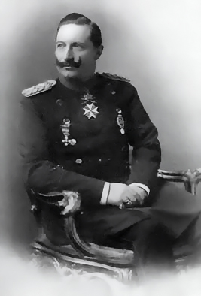
Versailles
Recap WWI
  1914 - 1918 hostilities
  German revolutions and mutinies break out November 1918
  Kaiser Wilhelm II, the German king abdicates on November 9, 1918 and German republic declared

Slide 4
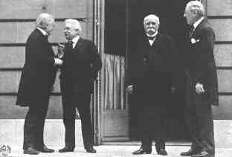
Versailles
  Armistice signed on Nov. 11, Allies maintain naval blockade of Germany until final peace treaty signed
  Big Four (UK, France, Italy, US) plus 22 others nations negotiate the treaty terms (no representatives from the defeated countries present)

Slide 5
Versailles
The final draft of the treaty imposed on Germany the following:
  Accept full responsibility for the war
  Pay reparations (over 30 year period; sum of what would be about $390 billion in current dollars)
  Cede all colonial territories
  Significant portions of former “German” empire

Slide 6
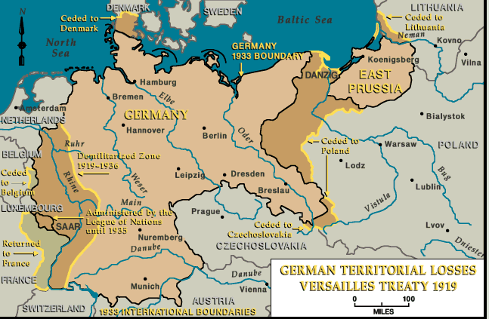
Versailles

Slide 7
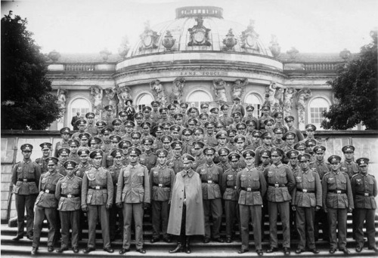
Versailles
Limits on army:
  100,000 soldiers
  no conscription

Slide 8
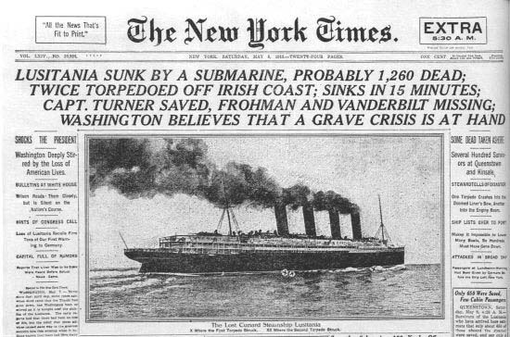
Versailles
Limits on navy:
  6 battleships, 6 light cruisers, 12 torpedo
  boats, 12 destroys
  No submarines
  15,000 sailors
  Surrender any and all ships not in German
  ports at that time

Slide 9
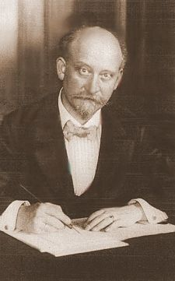
Versailles
Treaty of Versailles was presented to German government as fait accompli and compelled to sign
The German chancellor, the first democratically elected leader in the country, refuses to sign and resigns his position
Philipp Scheidemann

Slide 10
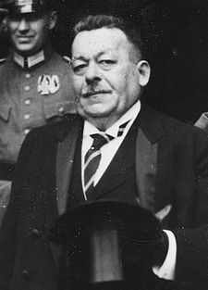
Versailles
  Allies threaten to renew hostilities
  Naval blockade remains in place (approximately 750,000 German civilians had died due to food and medical shortages caused by the blockade)
  New German president, Friedrich Ebert, signed the treaty under protest
Friedrich Ebert

Slide 11
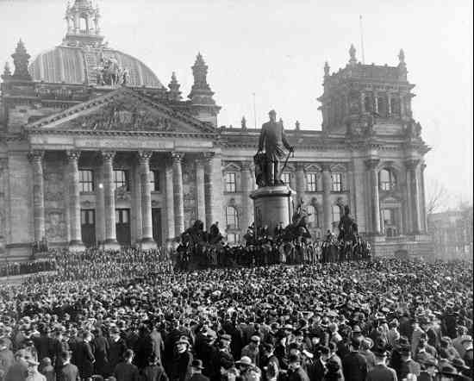
The Weimar Government
In Germany, a constitutional convention meeting in the town of Weimar drafts the first democratic constitution of a united Germany, in 1919

Slide 12

The Weimar Government
The Constitution provides for:
  Universal suffrage
  Democratically elected President with 7 year term
  Democratically elected parliament (Reichstag), with prime minister (chancellor) selected by President and cabinet (from list submitted by chancellor and cabinet had to reflect the party composition of
the parliament), proportional representation system

Slide 13

The Weimar Government
However, also provides that the President had the power to:
  dismiss the cabinet
  dissolve the Reichstag
  veto legislation
  use plebiscite (public vote) to bypass Reichstag
  emergency powers to allow cabinet to rule without consent of Reichstag if public order required it

Slide 14
The Early Years
The Weimar government gets off to a shakey start, facing opposition from a strong Marxist left (Marxist rebellions in 1919 and 1922) and a potent, but less organized, nationalist right (coup attempt 1920, assassination attempts in 1922; early Nazi coup attempt in 1923)
On the left, bitter about “betrayal” of socialist revolution and accuse the ruling Social Democratic Party of selling out the working class, the class that brought about the German republic

Slide 15
The Early Years
On the right, deep resentment about Versailles. Simmering and not so simmering resentment over the terms of the treaty and the “internationalist” sentiment that seemed to have led Ebert (and the Social Democratic Party) to accept the terms of the treaty

Slide 16
The Early Years
Weimar government is also saddled with the requirements, in particular the reparations payments of the Versailles treaty
Crippling economic problems following on the war and the extensive blockade exacerbate the crisis

Slide 17
The Early Years
Prior to World War, the German unit of currency, the Mark, was one of the strongest in Europe, trading on about equal value with the British pound, the French franc, and the Italian lira (about 4 or 5 for each to the dollar).

Slide 18
The Early Years
Following World War I, the German financial world collapsed and inflation was rampant
Indeed, from 1920 to 1923 Germany entered a period of hyperinflation such that at its worst, in 1923, the Mark traded at a trillion to one dollar

Slide 19
The Early Years
Prior to the war, the Mark was backed up by gold, so that for each mark there was an equivalent store of gold in reserve
Prior to the the war, the government predicted a short contest, and so opted to fund the war through borrowing rather than tax increases and savings

Slide 20
The Early Years
Rather than cut spending or raise taxes to pay for the war, the government continued to borrow and to print more money
As the war dragged, shortages and inflation became a problem so that the price of domestic goods doubled between 1914 and 1919

Slide 21
The Early Years
Inflation then continues to be an early problem for the new government
In January 1923, the government misses a reparation payment
In response, France and Belgium move to take the Ruhr valley -- the German industrial heartland

Slide 22
Germany 1919

Slide 23
The Early Years
Given the DMZ and the troop reductions, Germany unable to do anything
Instead, the SPD covertly supports workers’ strikes in the occupied areas, and opts to pay the workers (some 2 million people) to stay out
To do this, the government just prints more money and circulates the bills

Slide 24
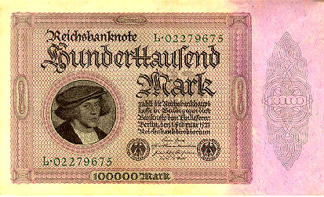
The Early Years
That decision leads to period of hyperinflation, wiping out the financial resources of most German families
How hyper you ask?

Slide 25
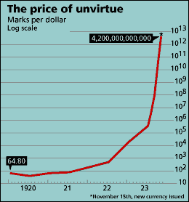
The Early Years
The monthly rate of inflation reached 3.25 billion percent (equivalent to prices doubling every 49 hours).
The U.S. dollar to Mark conversion rate peaked at 80 billion.

Slide 26
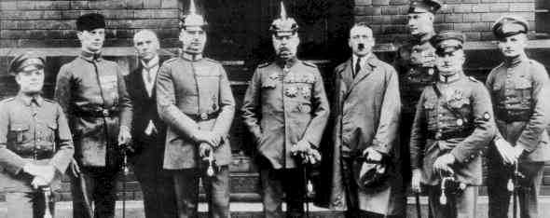
The Early Years
In early November, the SPD leader, Gustav Stresemann, stops the general strike in the Ruhr
This crisis provides the pretext for Hitler and
his fledgling Nazi party to try to take control of the
Bavarian government in Munich as a first step to
moving on Berlin

Slide 27
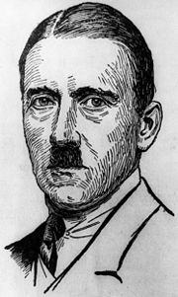
The Early Years
The coup attempt is put down, 16 Nazis are killed, and Hitler is arrested.
He’s tried and convicted of treason and sentenced to 5 years in prison
Pardoned and released in 1924 as part of general amnesty for political prisoners

Slide 28
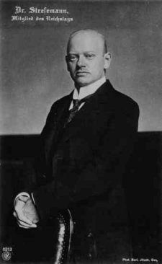
The Early Years
The situation doesn’t stablilize until mid November 1923, when the German central bank (the Reichsbank) introduced a new currency, the Rentenmark backed not by gold but by the mortgage on land and bonds on factories in the country
The new currency exchanged at 1 billion marks = 1 rentenmark
While the immediate crisis was resolved, it helped poison the political and social atmosphere
Gustav Stresemann

Slide 29

Weimar
The pointlessness of the war,
the flu epidemic, the post war
famine and the hyperinflation
strongly shaped youth culture in
the major German cities, particularly Berlin
Perception of why bother saving if the money is worthless, why bother studying if death is around the corner?
Rapid rise in drug use (cocaine in particular), prostitution, and general hedonism

Slide 30
Weimar
Politically, much finger pointing and blame for the economic crisis and the perceived moral decline of the populace
Parties on the extreme left (the Communist party) and the extreme right (various nationalist and conservative parties) begin to gain electoral strength despite the general economic stability from 1924-1929

Slide 31
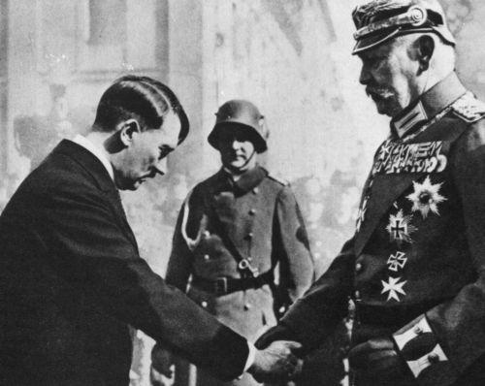
Weimar
With the coming of the great depression, the German economy collapses and parties on the extremes make significant electoral gains
Eventually the Nazi party is able to form a coalition with other nationalist and conservative parties to form a majority in the Reichstag

Slide 32
The End
On 30 January 1933, Hitler was named Chancellor of the Reichstag
A month later, on 27 February, the Reichstag is burned by communist radicals (allegedly)
Hitler uses that as a pretext to invoke Article 48 of the Constitution allowing for emergency powers

Slide 33
The End
Elections in March of that year do not give the Nazis the clear majority they need, but still have enough support from minor parties to form majority coalition
On 23 March, Hitler orchestrates passage of the Enabling Act, a law which gave Hitler and his cabinet the ability to pass legislation without going through the legislature

Slide 34
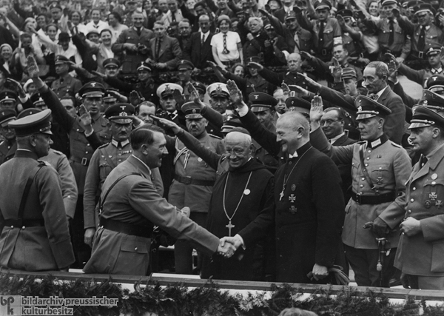
The End
Effectively ends the Weimar Republic

